Slide 1
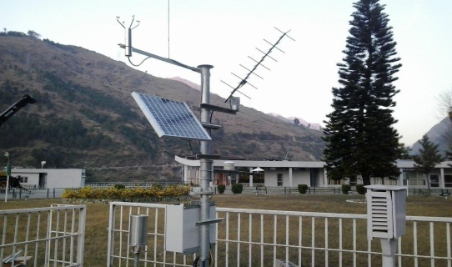
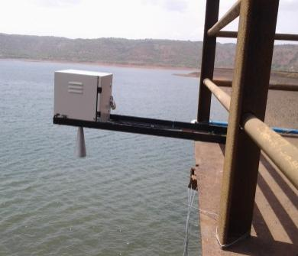
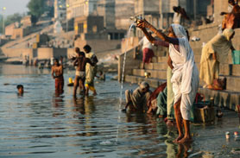
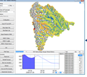
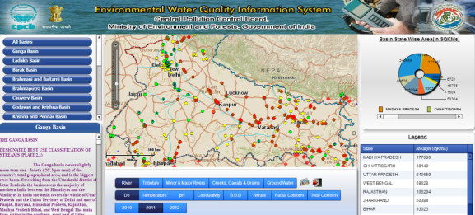
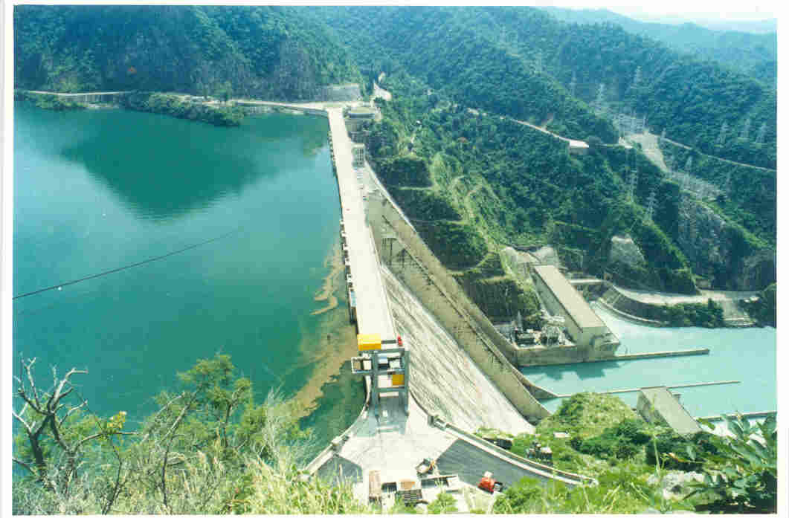
Integrated Water Resources Management:
National Hydrology Project (Phase III)
Preparation mission Wrap up: Feb 4, 2015
Dr. Anju Gaur
Senior Water Resources Specialist
The World Bank
agaur@worldbank.org
RELIABLE, TIMELY, QUALITY, CONSISTENT, PUBLIC DATA

Slide 2


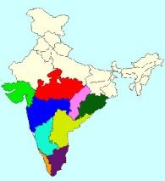
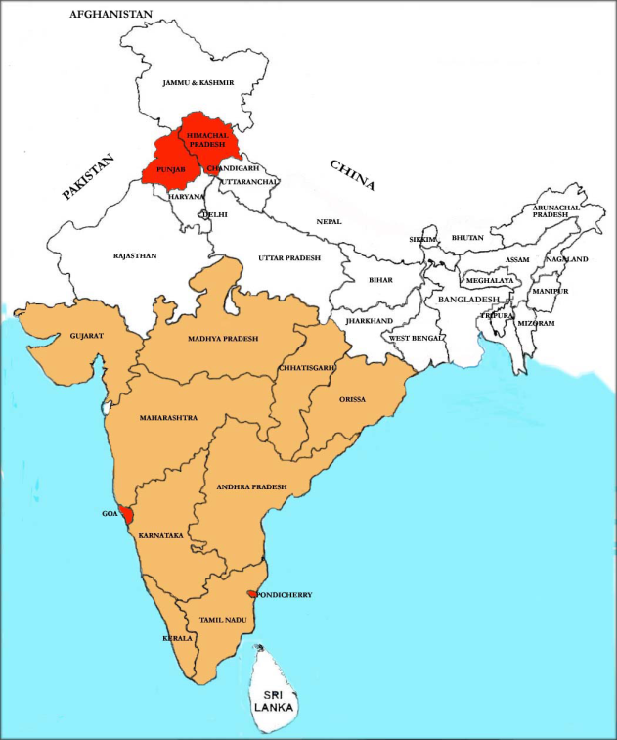
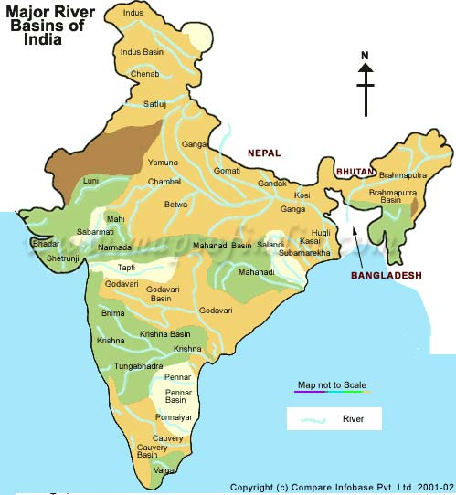
HYDROLOGY PROJECT – Journey Ahead
HP-I (1995-2003)
SDR 70.79 M
HP-II (2006-2014)
USD 105 M
National HP-III
(under preparation)
INDIA
Map not to scale
On Going States
New States
CWC, CGWB, NIH, IMD, MRWF, CPCB, SoI, NRSC, CWPRS, and BBMB, DVC
9 States
6 Central Agencies
13 States
8 Central Agencies
Across All Indian States
and Uts
10 central agencies
2

Slide 3
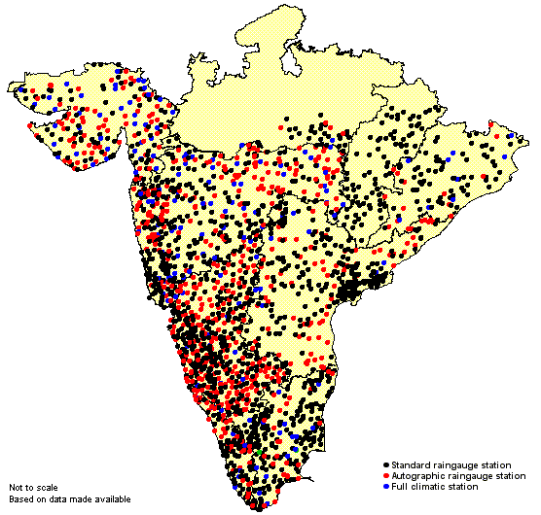

World Bank aided HYDROLOGY PROJECT
(1995-2003) SDR 70.79 M Hydrology Project-I (HP-I) was taken up to develop Hydrological Information System (HIS) for collecting hydrological, meteorological and water quality data.
(2006-2014) USD 104.98 M HP-II was taken up to extend and promote the use of HIS by all potential users concerned with the Water Resources Planning and Management, both in public and private, thereby contributing to improve productivity and cost effectiveness of water related investments.
INDIA
Nine States
Map not to scale
13 States
HP-1 States
New States
Both the projects were supported by International Technical Assistance

Slide 4

HP3: Project Design (Tentative)
Project Objective:
To Improve extent and accessibility of water resources information and Institution capacity to enable improved water resources planning, operation and management across India.
Project Components:
Improving In Situ Water Monitoring system (IWMS)
Improving Water Resources Information Systems (WRIS)
Water Resources Management Applications (WRMA)
Strengthening Institutions and Capacity Building
Budget Outlay: INR 3000 Crores (USD 500 million)
Effectiveness: Oct 2015
Moving towards a programmatic approach

Slide 5

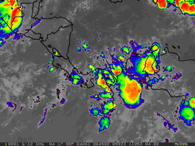

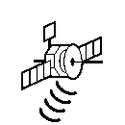
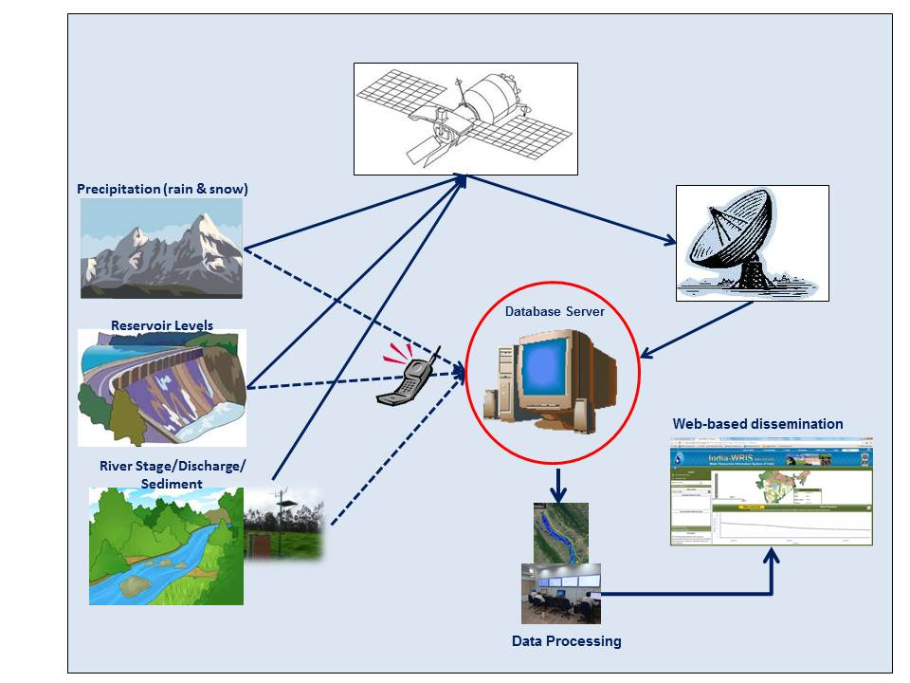
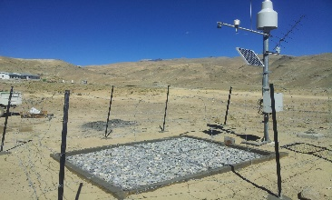

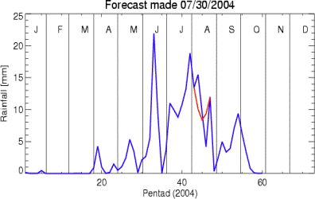

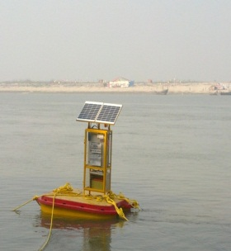
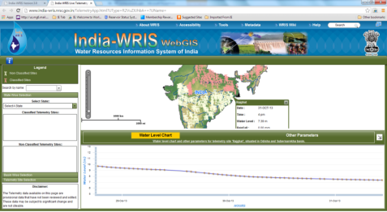

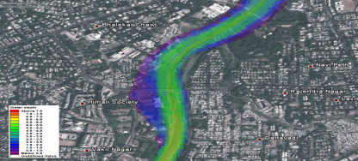
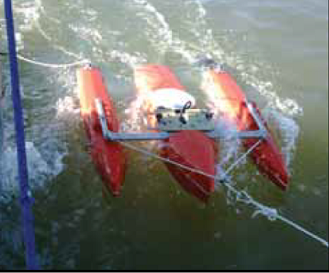
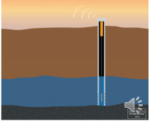
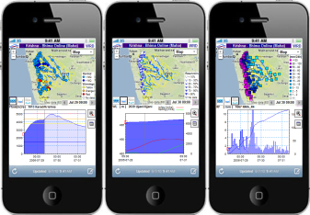
Data Generation
Bottom-up+Top-down
REAL TIME HYDRO-MET SYSTEM
Satellite based Climate
Data Transmission
(e.g. Satellite-InSAT, V-SAT, Cellphone)
Precipitation (rain & snow)
Reservoir Levels
Water Quality
Internet/ Intranet
River and Canal Stage/
Discharge/Sediment
Groundwater
Data Visualization & Use

Slide 6
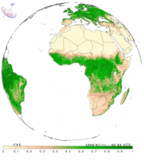
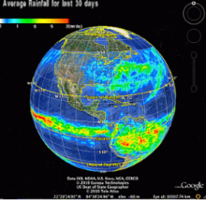
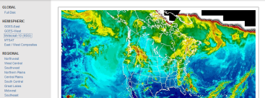
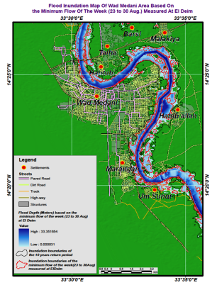

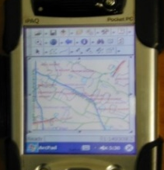




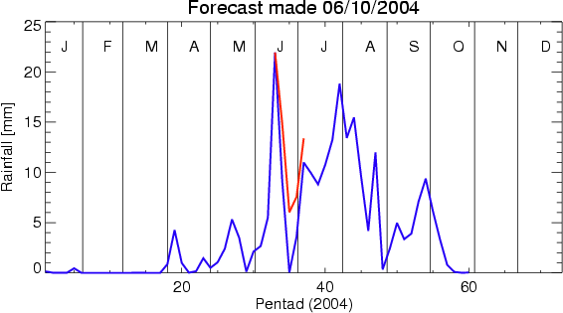
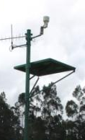

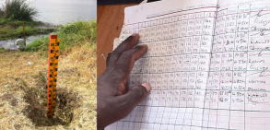
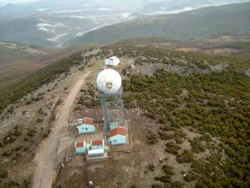
HP3 Vision: Water Information and application system
“Top-Down” Data Acquisition System
Web Portals
(e.g. integrated hydromet. visualization platforms)
GIS and other data sets
Data Rescue
Satellite Earth Observation
Earth observation data access via suitable mechanisms (e.g. Internet, GeoNetCast)
Data Repositories
to store and serve
both raw feed and processed data
(on Cloud Platform)
Interaction with other Knowledge Base and Analytical Systems
Dissemination Platforms
Crowd-sourced / Community Surveillance Data
Stakeholder Alerts
Telemetry
Data Management & Modeling
(for weather, hydrological, inundation & other forecasts – short-term and seasonal)
Operational Control Rooms
Manual Monitoring
Automated Monitoring
Radars
“Bottom-up” Data Acquisition System

Slide 7

Approach
Issues
Development of Hydrological Information System
Planning
Water Budget
Reservoir Operation
Flood Management
Conjunctive use
GW study/ management
Drought Management
Irrigation/hydropower development
Climate change adaptation
WQ/ Saline intrusion
Operation
Flood Forecasting
Reservoir operation
Canal optimization
Irrigation scheduling
Data from State:
Rainfall
Met parameters
Discharge
Reservoir releases
Canal flows
WQ
Sediments
Water abstraction/ demands
Introduce
Tools
&
Techniques
Analysis and Scenarios
Data from Centre :
DEM
Toposheets
Land use
Satellite image
Weather forecast
Interface Development for Decision Making
Capacity Building
and
Institutional Development

Slide 8
Major issues and Project interventions
Issues | Project intervention
Dynamic and detailed assessment of water resources is not available. | Improve the extent of water resources monitoring system and river basin assessment system.
DPRs require sound data and designs to prepare cost efficient solutions. | Standardize historical Database and Hydrological design aides and make them accessible online. Improve exchange among central and state through National Water information center
Flood damages are in the range of INR 6000 crore/year | Modernize Flood forecasting and Reservoir operation system linked with Climate forecast to minimize the flood impact.
Irrigation systems are highly inefficient | Improve irrigation operation system through transparency in monitoring and updated information to users. Strengthen DSS for water allocation and distribution.
Ground water is depleting | Improve understanding of aquifers and surface groundwater interaction
8

Slide 9
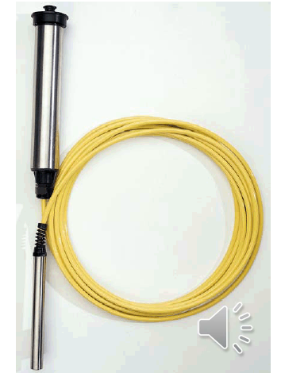
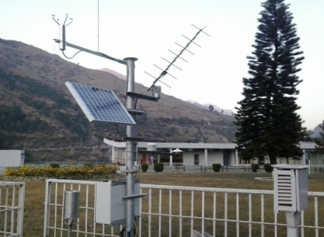
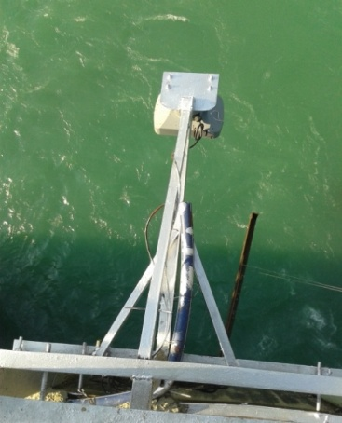

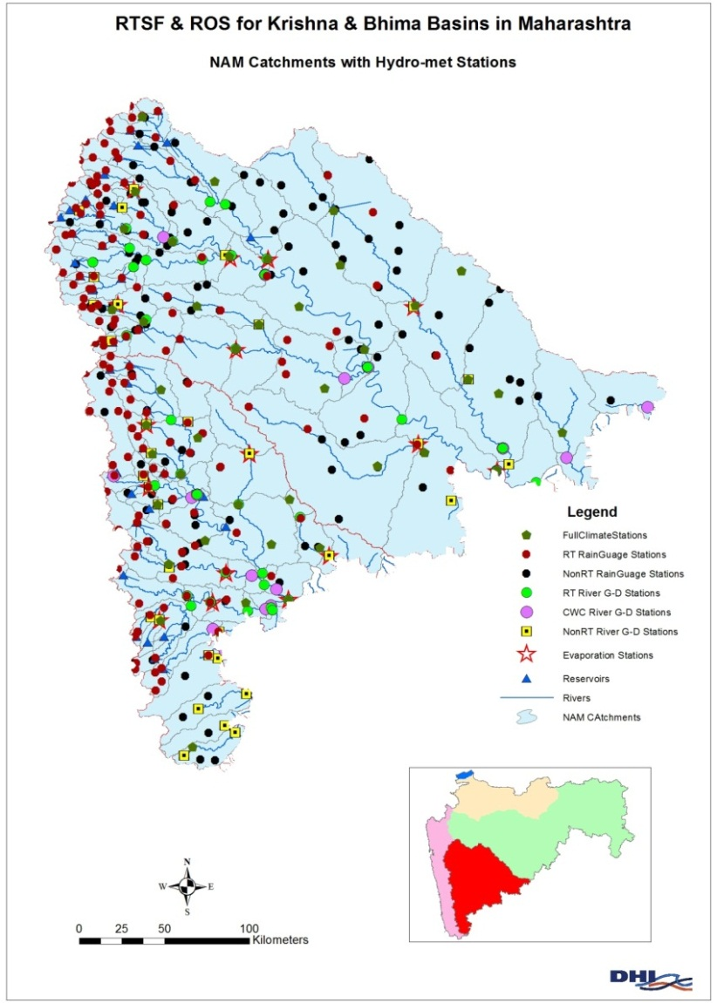
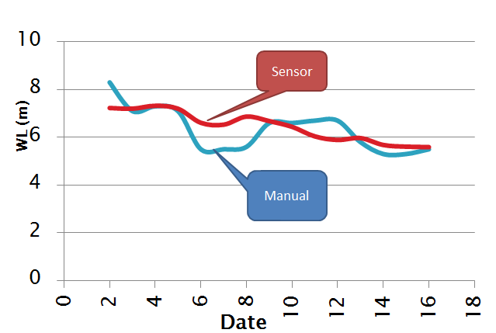
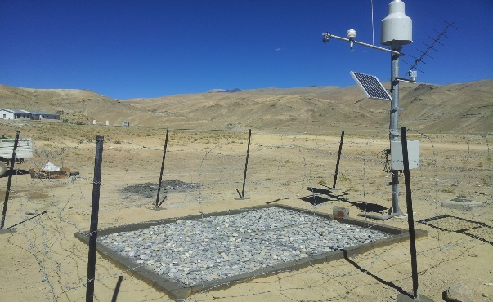
Component A: Improve In Situ Monitoring System
Automatic Weather Stations
Water Level Recorder
Water Quality Station
Digital GW Recorder
Snow Pillows
River Flow
  During HP2: Six states have implemented the system
  - Reliable and timely data in several states of India
  - Saving in operating cost by 50% of manual cost.
9

Slide 10
Component A: Improve In Situ Monitoring System
  Actions for HP3,
  Optimize Hydro-met System
  Technical support: NIH has agreed to design Hydro-met and conduct course to design the Hydro-met system
  States may engage expert till central TAMC is in place
  New States should visit HP2 states.
  Optimize Telemetry:
  Since VSAT is comparatively expensive, it may be adopted only for flood related systems and GSM/GPRS for remaining sensors.
  In case of GW, DWLR with GSM telemetry may be proposed because cost difference between with and without telemetry is not significant
10

Slide 11
Component A: Improve In Situ Monitoring System
  For HP3,
  Technical support for procurement of Hydro-met sensors
  NIH will design in coordination with CWC and IMD
  CWPRS will guide the specification and selection of sensors.
  A centralized cell/committee needs to be established to update the listing of the model/make for each sensor and provider.
  The report on performance of providers will be compiled in consultation with HP2 agencies.
11

Slide 12
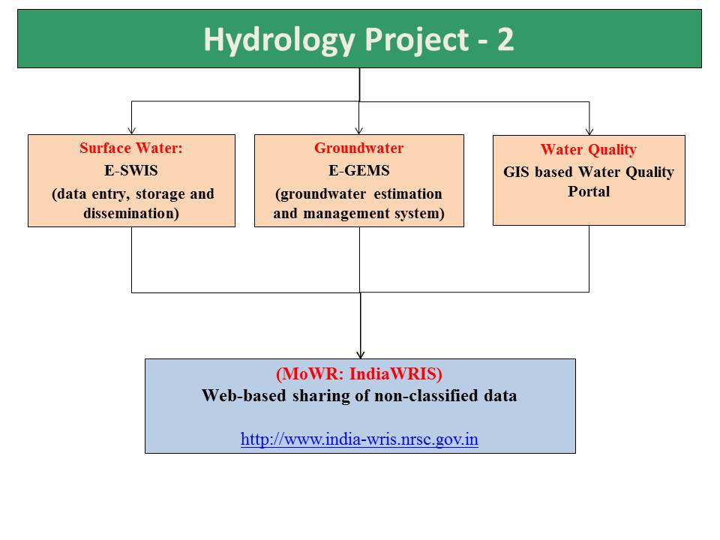

Component B: Improving Water Resources
Information System
Advantages:
Standardized database with reliable, transparent and timely access to data.
Expedite Plan Preparation for water investments using state owned data.
Enhance exchange among state and central agencies at real time to make decisions at river basin level in particular for flood management and reservoir operation.
Maharashtra, Karnataka, Tamil Nadu, Puducherry are sharing data in public

Slide 13
Component B: Improving Water Resources
Information System
Plan for HP3:
Upgrade E-SWIS to include Irrigation system performance
Upgrade e-GEMS for aquifer information system
Introduce Web-based Generic models
Introduce community based monitoring for canal and groundwater

Slide 14
Component A&B: Centralized Web-Based Water Resources Information System
Updated information from Central Agencies will be key to India WRIS
  Survey of India
  NRSC
  CWC
  CGWB
  IMD
  CGWB
and States
States may also develop their own chapters.
Upgrade India WRIS into
National Water Information Centre
The protocol for WRIS needs to be developed and shared so that States can follow the same
Data/information sharing protocol would play key role in updating multi-disciplinary data and making them accessible

Slide 15
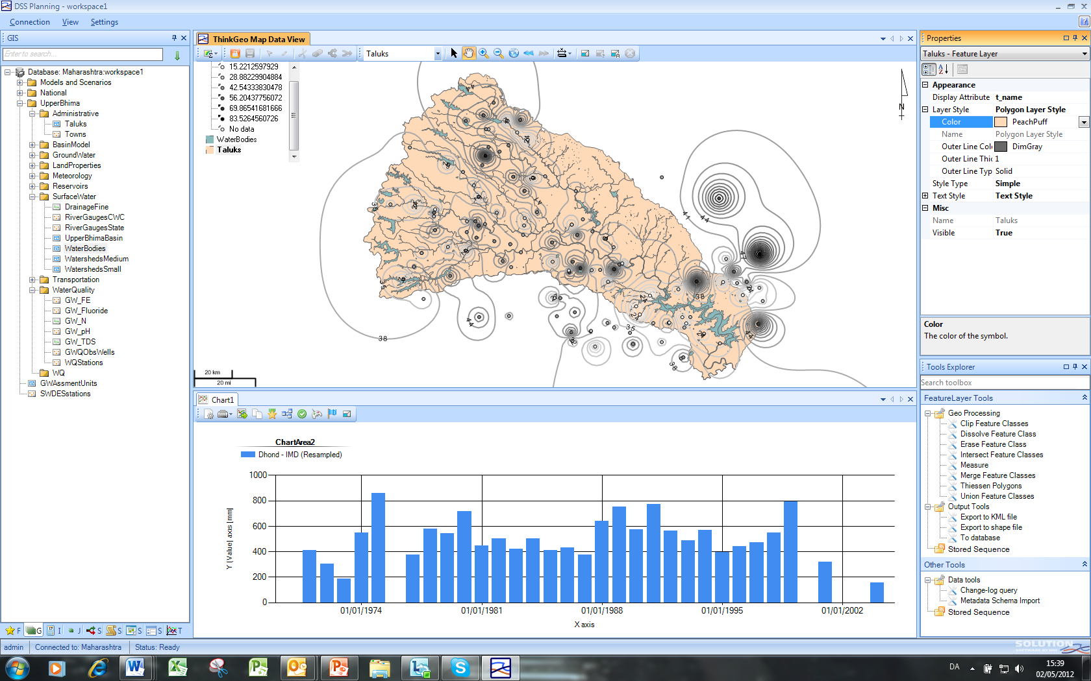
Component C: Water Resources Management Applications
During HP2, Nine states developed DSS, now will be upscaled to other river basins
Properties
Model Display
Model explorer
Select items/ Display chart
Tools

Slide 16
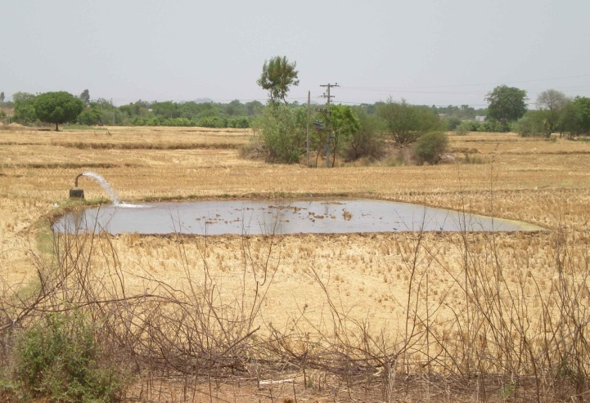
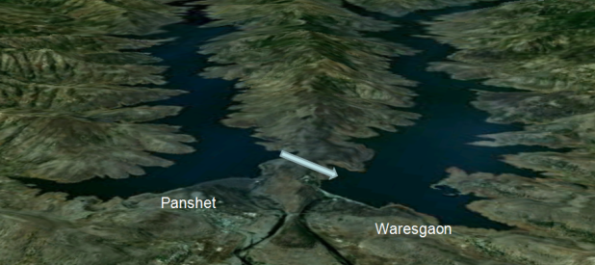
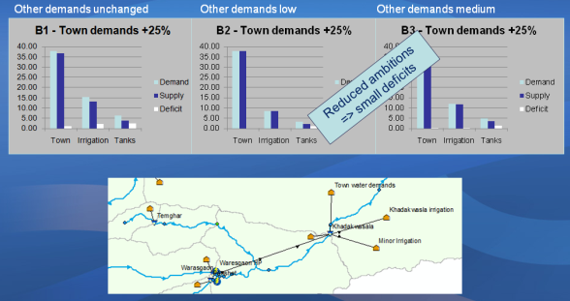
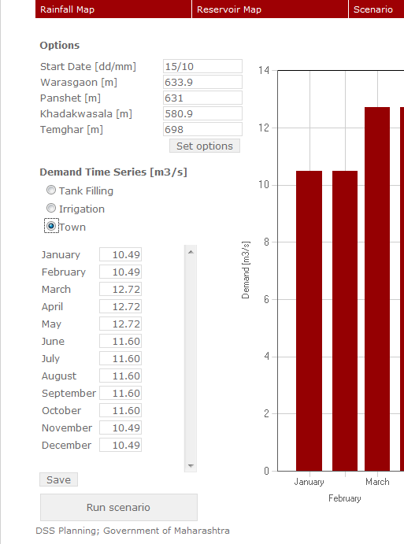
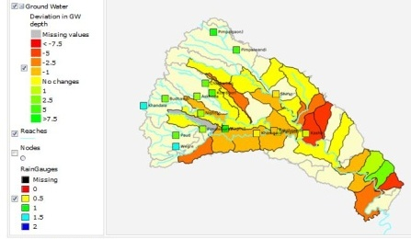
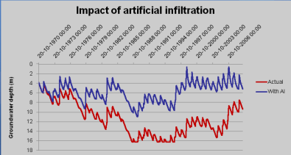
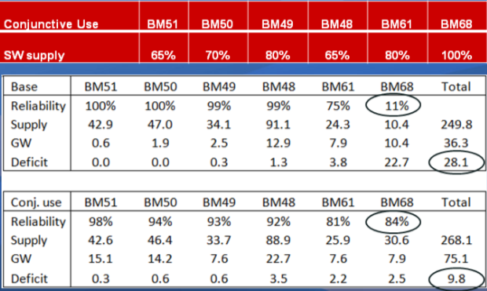
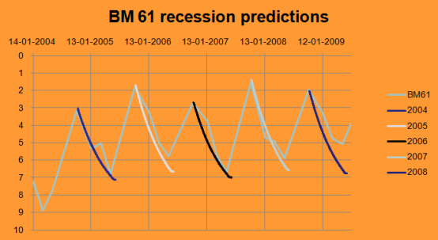
Component C:
DSS for River Basin Planning and Management
Meeting Future Demands
Seasonal Planning SW
Inter-dam Transfer
Artificial Recharge
Drought Monitoring
Cost effective designs and investments
were supported during HP2 and
will be up-scaled during HP3
Seasonal Planning GW
Conjunctive Use
Value
The states can now optimize their management of surface and groundwater, prioritize problems, test efficiency of possible solutions, and increase the awareness and participation of stakeholders in meeting the challenges of securing water for future generations.
“We must start using the DSS for conflict resolution among states sharing the same river basin resources”
- Senior Government Engineer, WRD, Maharashtra
The formation of river basin modelling group by CWC and Riparian States,

Slide 17
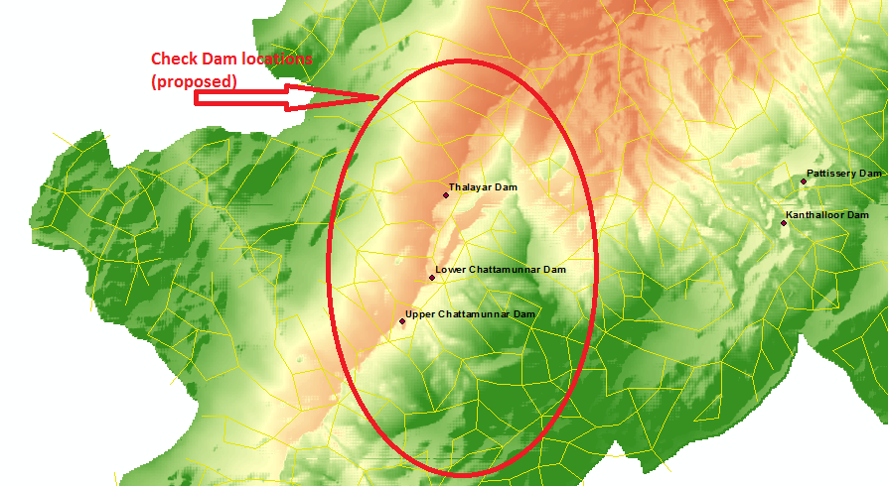
Component C: DSS for River Basin Planning
  12th five year plans to invest INR 2,800 billion for Agriculture and Water Resources Development, even one percent saving in investment through uniformed planning would account for INR 28 billion
During HP2, Maharashtra saved
INR 100 of crores by stalling link tunnel.
INR 3.8 crore per year in Pune water supply system
Kerala saved 100s of crore through minimization of flood, optimum design of check dams and other investments.
Other states also have similar experiences to share

Slide 18
Component C: Irrigation operation system
  Some states have proposed for integrated reservoir operation system with SCADA
- The system would be expensive and will be only piloted in some areas.
- The states are also encouraged to introduce community based monitoring and use them in canal roster and operation system

Slide 19
Component C: Irrigation Operation System
  Use technology such as Mobile, Remote sensing and community to improve the irrigation scheduling and roster information
NRSC has introduced the irrigation system performance tool.
MP is sharing administrative progress for each division
Combining both will give irrigation department a tool to optimize the canal roster and operation.
Productivity will improve if farmers are informed about actual roster in timely manner

Slide 20
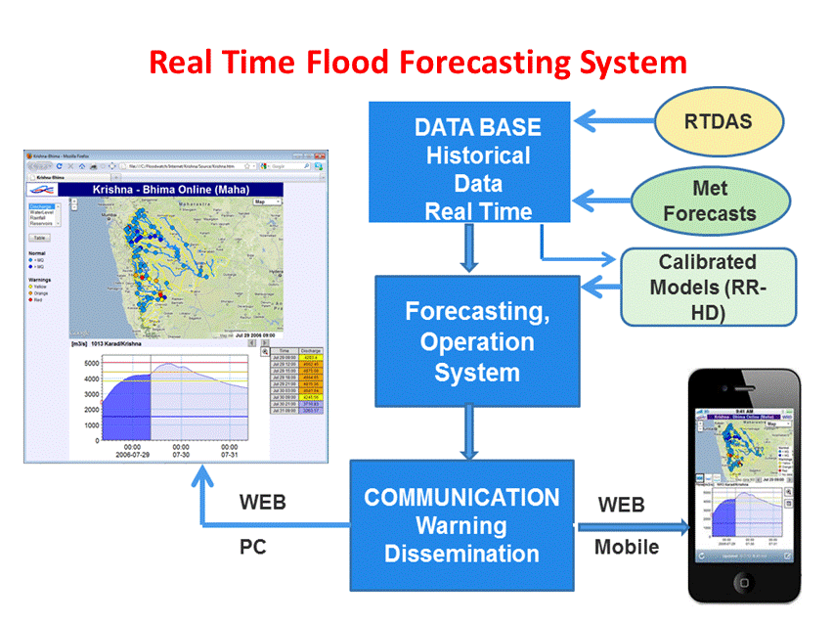
Component C: Flood Management
  During HP2: Stream Flow Forecasting and Reservoir Operation
  Systems for Flood Management in three River Basin Systems
Bhakra – Beas Basin
Upper Krishna & Bhima Basin
As per 12th Fiver year plan, annual flood damage to private infrastructure and property to be US$1 Billion (INR 6000 crore) and 3.2 Million people

Slide 21
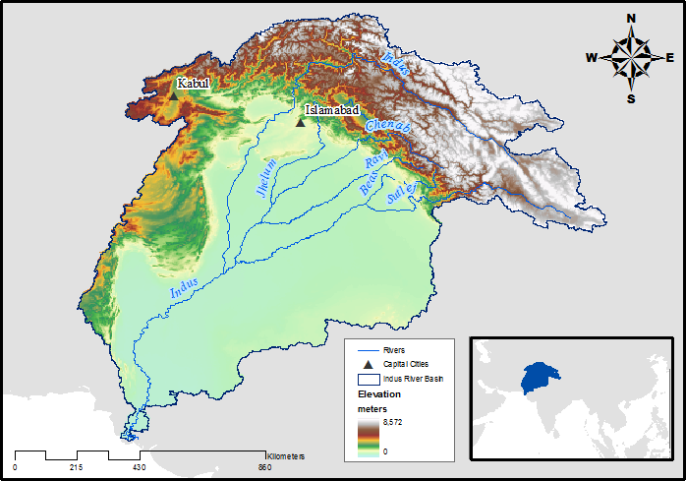
Benefits of River Basin DSS
RAINFALL FORECASTING
SNOWMELT FORECASTING
- IMPROVE LEAD TIME FROM HOURS TO DAYS
-MINIMIZE THE WASTAGE OF WATER
- MAXIMIZE THE ECONOMIC VALUE OF WATER
- EASY, EFFECTIVE AND EFFICIENT MANAGEMENT
OF THE RIVER SYSTEM, RESERVOIRS, HYDROPOWER AND THE
VARIOUS HYDROLOGIC STRUCTURES
RIVER ANALYSIS AND MODELLING
RESERVOIR MANAGEMENT
RESERVOIR
GATE OPERATION AND FLOOD FORECASTING
DAM WITH GATES
POWER
HOUSE
PARTNER STATES
In Krishna basin, flood damages were 300 crores and >80 lives
In Bhakra system, flood damages >85-240 crores
HYDROPOWER MANAGEMENT
OPTIMUM DISTRIBUTION
CANAL NETWORK OPTIMIZATION
PARTNER STATES

Slide 22

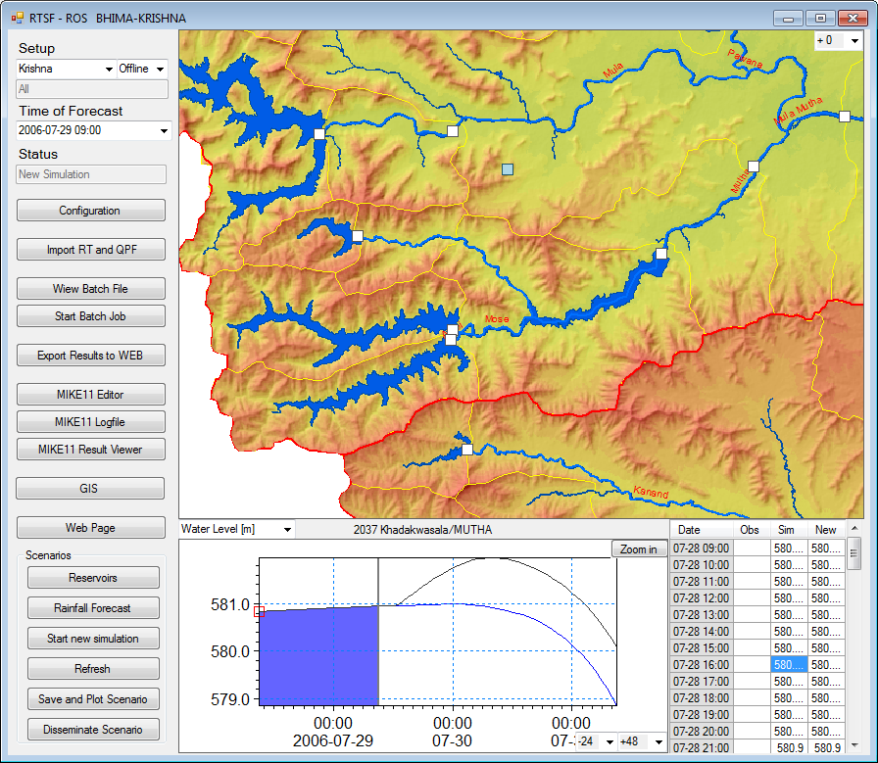

CWC and Project flood forecasting system
In small Catchments such as Koyna Dam has hardly 3-4 hours to operate the reservoir after the rain, therefore the climate forecast plays a greater role to prepare for releases
CWC uses upper river levels to forecast the flood in downstream which is good for large river basins
www.rtsfros/krishna/source/krishna.htm

Slide 23
Component C: Flood Management
  During HP3, Centralized flood forecasting system in association with
  IMD will be introduced and
  States/RBOs will be motivated to setup their online system.
MoWR is coordinating with
IMD for improved and real time weather forecast System.
Survey of India and NRSC to provide DEM for flood mapping developed through Satellite and LIDAR Survey
MoU to be signed among concerned agencies
Bhakra – Beas Basin
Upper Krishna & Bhima Basin
The formation of river basin modelling group by CWC and Riparian States,

Slide 24


Component C: Groundwater management
During HP2, six pilots were tested to develop time and cost effective techniques for geophysical measurement.
HP3 program will support:
Support National Aquifer Mapping program through innovative systems
Study Surface-groundwater interaction
Community based groundwater monitoring and management
Included collaborations with NGRI India; Aarhus University. Denmark and technical guidance of USGS
24

Slide 25


Component D: Improving Institutions and Capacity Building
Integrated Water Resources Knowledge Centers
  Establishment of the National Water Informatics Center: Institutional Arrangements are to be worked out.
  River basin modelling centers: Select river basins to pilot
  Groundwater modelling center: Initiate selection of region and planning
Center of excellence at central and State levels:
To facilitate knowledge exchange:
  With internationally reputed Institutes
  States may consider reforming WALMIs/IMTI
  Project is not limited to Hydrology and aims at excelling in irrigation management also.

Slide 26
Component D: Improving Institutions and Capacity Building
Capacity building
Design special training/course in association with the reputed institutes.
Project will facilitate specialized degree program/certificate courses.
Staff Assignment
Assign the staff who is interested in Hydrology and water management
Continuity of staff should be ensured otherwise capacity building goes waste.

Slide 27
Component D: Improving Institutions and Capacity Building
  Actions for HP3,
  This component is not only about construction of data centers or incremental staff. PIPs need to strengthen capacity building through training and exchange programs.
  The project does not aim to create new work, rather aim at making current practices in the department more effective.
  Therefore the agencies need to ensure the assignment of appropriate staff members and strengthen nodal agency.
  MoWR
  TAMC needs to be in place by project effectiveness
27

Slide 28
PROPOSED INSTITUTIONAL CONCEPT
NRSC
National Water Informatics Centre
(within CWC)
National Centre of Excellence
IMD
Data Exchange
Training and R&D
India-WRIS
Technical Collaboration
SoI
Data Exchange
Technical Collaboration
State Data Centre/ State Water Informatics Centre
State chapter of India-WRIS(website)
State WR e-library
WR Planning & Applications
State Centre of Excellence
STATE RESEARCH & TRAINING CENTRE or
WALMI or Local University
Collaboration with International/National Research Organization & Universities
District Data Centre
Data sharing
Technical Collaboration
Training and R&D
Data exchange
Data exchange
Agriculture Dept.
PHED
Environment Dept.
Disaster Management

Slide 29
Implementation Arrangement
Implementing agencies may include:
- All States and territories are welcome to join the project
10 Central agencies: CWC, CGWB, NIH, IMD, CPCB, SoI, NRSC, CWPRS, and BBMB
Agency wise Budget allocation
The program will be flexible and will be updated during Mid term review or as needed. Well performing agencies will be given preference during budget reallocation.
Retroactive Financing (one year) will be applicable provided World Bank procurement procedures are used.

Slide 30
Tentative Fund flow System
(MoWR to confirm)
World Bank
State
(with counterpart funding)
RBO/
Non-MoWR organizations
(Grant in aid)
Central Organization
MoWR,
RD&GR
CAAA
HP2 Loan
Fund flow mechanism from MoWR to states needs to be simplified to ensure timely release of funds.
States are advised to work with MoWR to develop the procedures

Slide 31

World Bank Project Cycle
We are here
EFC
October 2015
July 2015
Cabinet Clearance

Slide 32
DEA Readiness for project
S. No. | Key activity/ milestone | Timeline | Status
1 | Advice regarding funding arrangement to States by MoWR and Administration approval by States | Immediately | Advice from MoWR is awaited.
2 | Institutional Arrangement | Immediately | MoWR and 30% state agencies need to strengthen.
3 | Procurement plan approved | May 2015 | Yet to be initiated
4 | Preparation of DPRs and bid documents | Feb 2015 | Yet to be initiated
5 | Approval of bid document | March 2015 | NA
6 | Award of consultancies | Sep 2015 | MoWR with TAMC by Sep 2015
7 | Award of 30% of tender documents | Sep 2015 | Bids not finalized during HP2 can be floated soon.
8 | Approval of EFC/Cabinet | Central clearances will be secured by PCS MoWR.

Slide 33
Project Timeline
S. No. | Activity | Agency | Due by | Status
1 | Final PIP | States | Feb 28, 2015 | 80% agencies responded. 70% agencies are approaching completion.
2 | Finalization of PIP by MoWR | MoWR | March 15, 2015
3 | Submission for EFC clearance | MoWR | Jan 2015
4 | EFC Clearance | MoWR | March 2015
5 | Project Appraisal | WB | May 2015
6 | Negotiation | WB/ MoWR | July 2015
7 | Submission to World Bank Board for clearance | WB | August 2015
8 | Cabinet approval | MoWR | Sep 2015
9 | Effectiveness |  | Oct, 2015

Slide 34
Tentative Budget Allocation Criteria
Initial budget allocation:
Geographical area and population of each State,
Level of performance of existing HP States under HP-II, and
Implementation capacity and readiness of new States.
During implementation:
The allocation will be reviewed on annual basis and during mid term, re-allocation will be pursued based on following:
Performance of the agency
Need of the agency
Availability of funds
In case budget exceeds the demand, arrangements for additional financing will be pursued.

Slide 35
Implementation capacity and readiness
  Implementation Capacity and readiness were determined based on
  Existing HIS,
  Dedicated nodal office
  Staffing capacity to implement the project
  Status
  Participation: All the states excepting Tripura, Manipur and KT GW have indicated the interest to join the project.
  Out of 38 State IA,
  29 agencies seemed ready (scoring >=3 at the scale of 5)
  Bihar GW, Chattisgarh, Haryana, MP, Orissa, Sikkim, Uttarakhand, UP SW and GW need to strengthen nodal office and implementation team.
35

Slide 36
PIP Preparation
  Content
  PIP will consist of following
  Cost estimate (excel format)
  Descriptive report (Word Format template shared)
  Detailed Descriptive report (Template will be shared soon)
  Baseline of HIS (Excel format)
  Institutional Arrangements (Excel format)

Slide 37
PIP Preparation
  Out of total 55 agencies
39 agencies submitted prelim PIP. Consultation was held with 37 agencies during recent mission. Out of which 14 agencies are nearing PIP completion
Status of remaining 18 agencies: KT GW and Manipur have not responded at all, Haryana and Tripura are interested but no active response, DVC or other river boards require invitation, no response from territories excepting initial submission of PIP by Puducherry. Punjab PIP is also pending.
Majority are requesting more that their budget allocation. Therefore agencies have been advised to prepare in two time slots (Yr 1-5 and Yr 6-8): Priority and Dream PIP. Dream PIP items will be considered as additional items after MTR based on their performance and availability of funds.

Slide 38
Convergence with other projects/sources
  Ongoing World Bank projects
  SoI has agreed to map (LiDAR or equivalent) the funding resources for mapping India and use HP3 for remaining priority area.
  The states such as UP, West Bengal, Bihar and Uttarakhand may also converge with existing state projects to obtain additional sources and expedite implementation.
  National Aquifer mapping and state plans need to converge

Slide 39
Summary and conclusions
  MoWR
  Advice for funding arrangement by MoWR to the states.
  Devise fund flow system from MoWR to states which would ensure the fund availability by March of each year (State indicated that under current central assistance, the first installment is made available only by Sep-Oct).
  Initiate procurement of TAMC to have it in place by effectiveness of project.
  MoU for Data sharing with IMD, SoI and NRSC.

Slide 40
Summary and conclusions
Technical support by central agencies:
NIH has agreed to design Hydromet
CWPRS alongwith the committee will work on listing the make and model of sensors and providers.
CWC and CGWB need to aspire more for modernizing training and capacity building.
PIP by central agencies yet to be finalized.
States:
Establish nodal agency and assign the staff.
Prepare bid documents for RTDAS, data center, and consultancy

Slide 41
State Institutions
States need to make Institutions ready for implementation and sustainability
Strengthen department engineers/scientists
  Hydromet
  River Basin Modelling
  Procurement
Through:
  Identification of “right” team
  Identify local academic and research to collaborate with and develop training programs.
Reform WALMIs to modernize the training programs
41

Slide 42
MIS
  Stay tuned to website www.indiawrm.org /MIS
  Register through assigned mobile,
  Contact MIS specialist at indiawrmhp3@gmail.com for further guidance
  Use DMS to submit PIP
  Update contact info.
  Social media:
  Use message board for exchange of ideas.
  Join Whatsup group

Slide 43
'If You Can't Measure It, You Can't Manage It‘
Thank you
agaur@worldbank.org

Slide 44


India Water Resources Management Program – Hydrology Project (Phase – III)
RELIABLE, TIMELY, QUALITY, CONSISTENT, PUBLIC DATA

Slide 45
Concepts of Hydrology Project –Phase III
Standardizing Water Resources Monitoring and Information System for the country with uniform procedures and database.
Enhancing data exchange between Centre & States.
Improving access to information in the public-domain.
Introducing country wide generic solutions for flood forecasting and water resources management.
Developing site specific solutions for water resources planning, operation and management including used of remote sensing based techniques.
45

Slide 46
Overall Major actions/Challenges
Optimize Hydromet with respect to issues: NIH has offered to work in consultation with other agencies.
(Real time) Data (and products) sharing protocal among central and state agencies in particular IMD forecast and Spatial information from SoI and NRSC.
River basin flood and IWRM: Constitution of River Basin modelling team including CWC and Riparian states for flood management
Availability of technical experts for Hydromet and Modelling: States may consider coordination with local academic/research centres to have long term partnership.
Hydromet suppliers and providers: For O&M, states need to strengthen their own team for sustainability
46

